Slide 1
Scaled Agile Success:
Conceptual Framework
Exploratory Data Analysis — Key Findings
DANA8411 | 60 Respondents | 59 Scale Items | 2026

Slide 2
Agenda
What this presentation covers
01
Study overview — who responded and how the survey is structured
02
Finding 1 — Team-level practices are the highest-rated section
03
Finding 2 — Success outcomes rated at or below neutral (3.0)
04
Finding 3 — Importance vs implementation gaps are very small
05
Finding 4 — Survey is highly reliable (Cronbach's α > 0.84)
06
Finding 5 — Experience & role shape perceptions
07
Correlation insights & strongest item relationships
08
Conclusions & recommendations for the conceptual framework

Slide 3
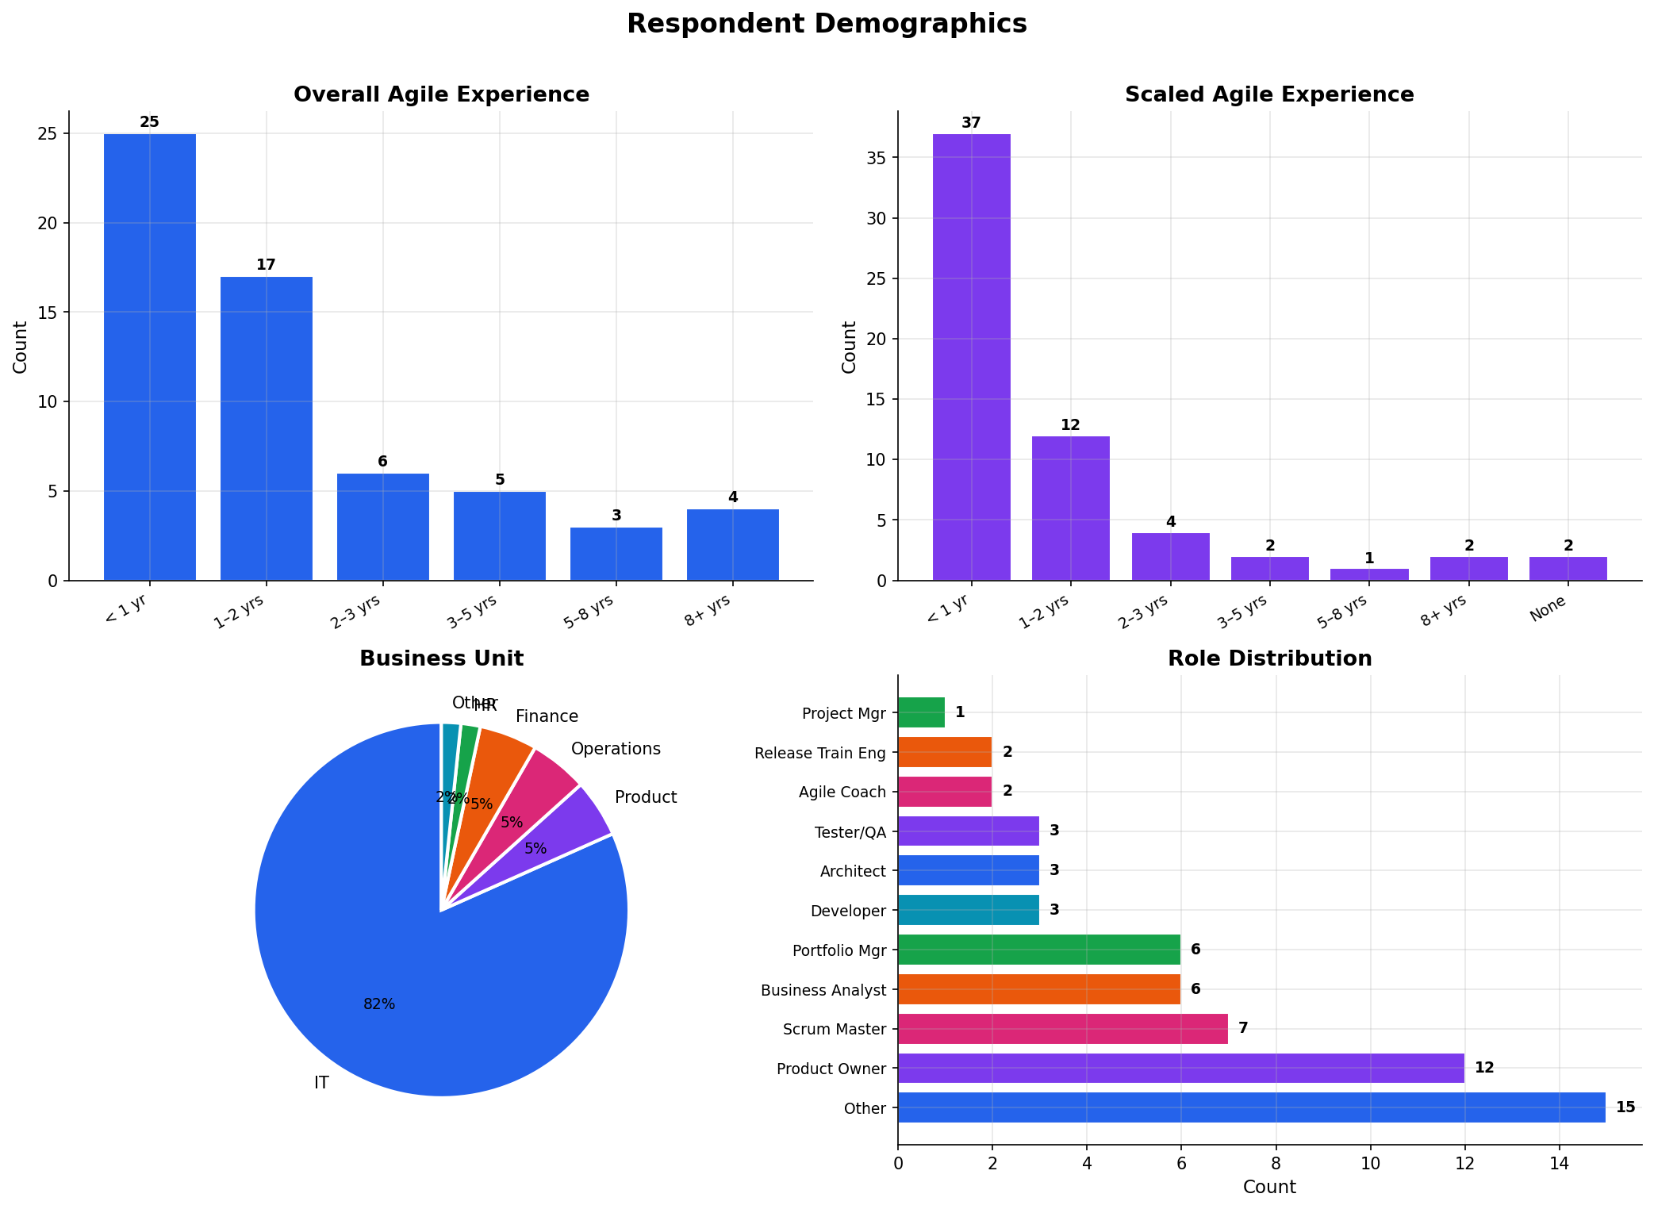
Study Overview
Who responded and how the survey is structured
60
59
9
IT
Survey Respondents
Likert-Scale Questions (1–5)
Survey Sections Analysed
Dominant Business Unit (50%)
Respondent Profile

Slide 4
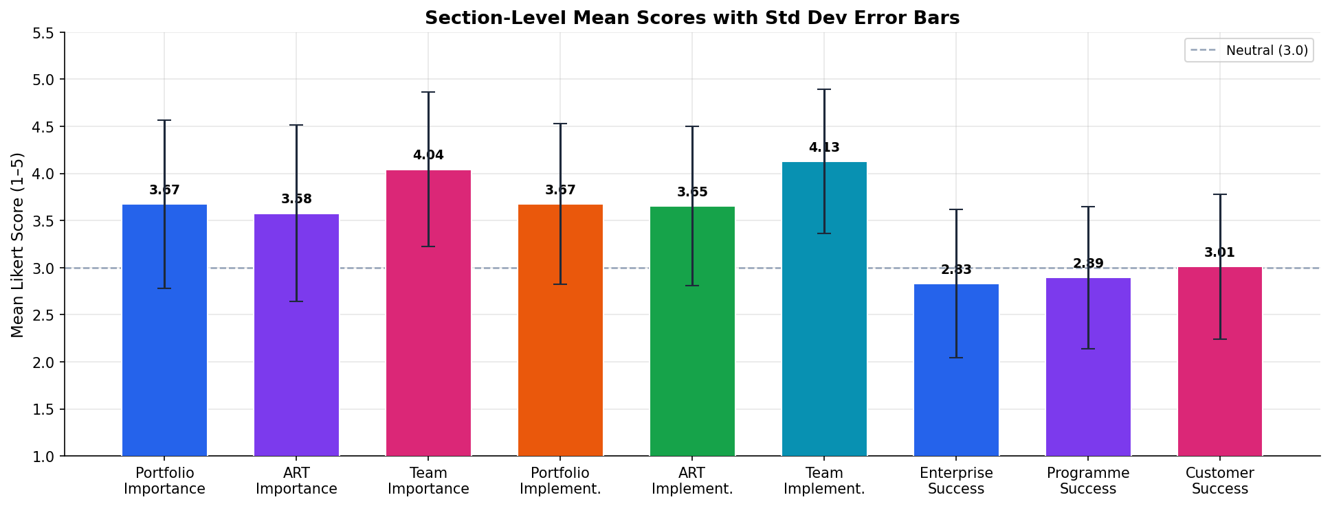
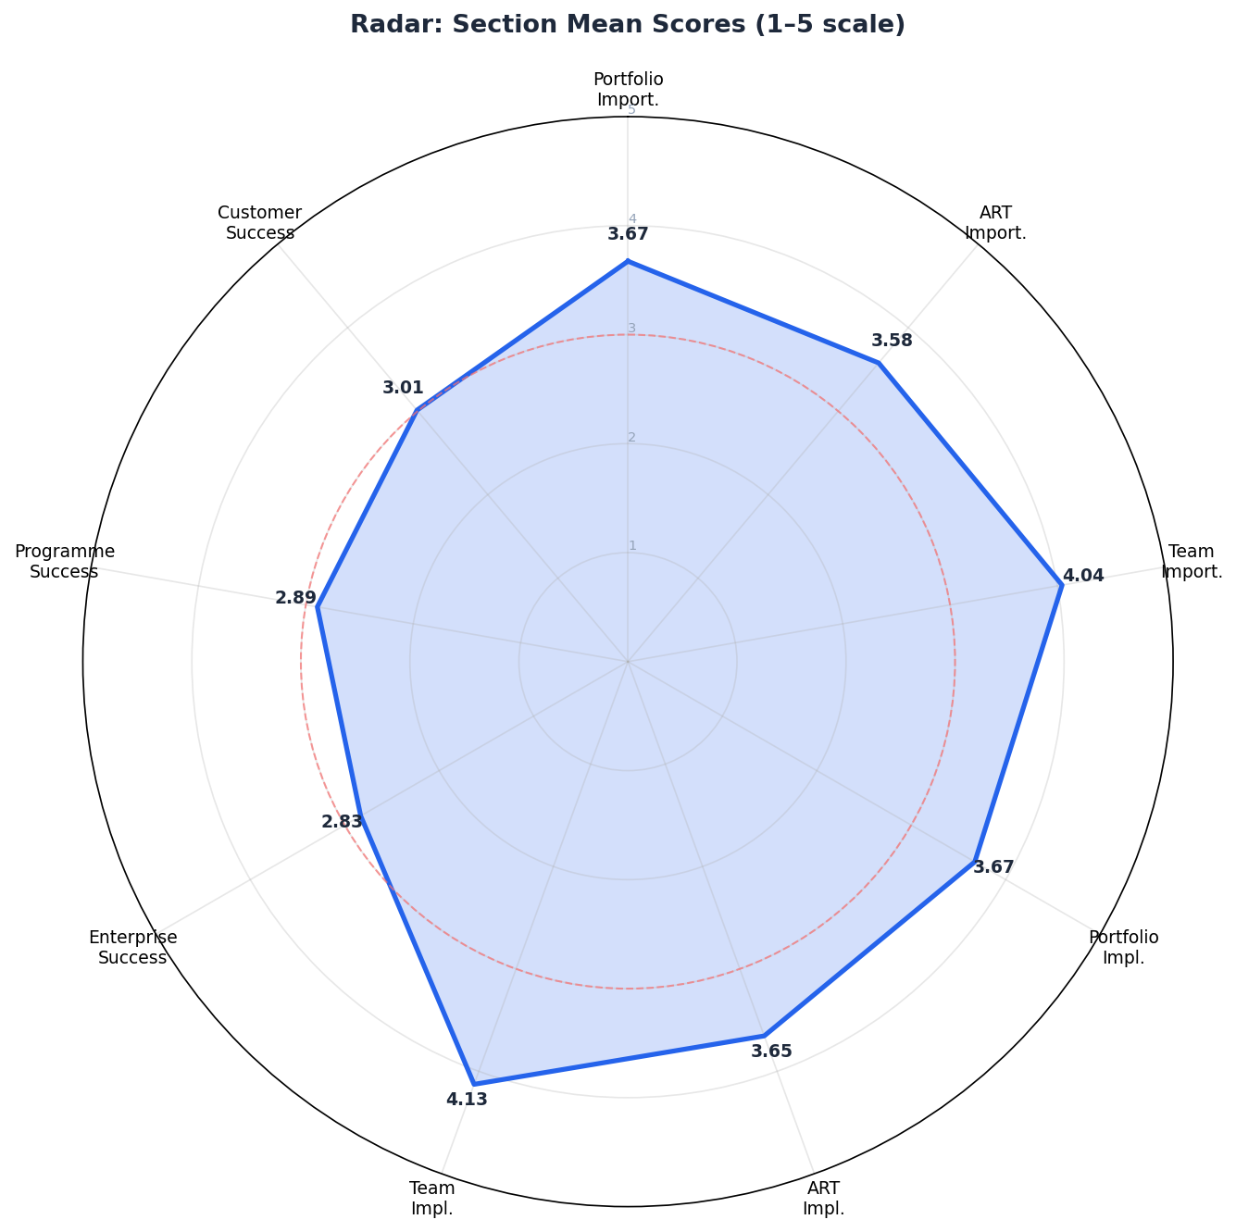
Section Score Overview
Mean Likert scores (1–5) across all 9 survey sections — neutral line at 3.0
Key pattern: Team capabilities (Q8/Q11) score highest (~4.1). Process & governance sections (Q6/Q7/Q9/Q10) score moderately (~3.6). All three success indicator sections (Q12/Q13/Q14) score near or below 3.0 — suggesting practitioners are doing the work but not yet achieving the outcomes.

Slide 5
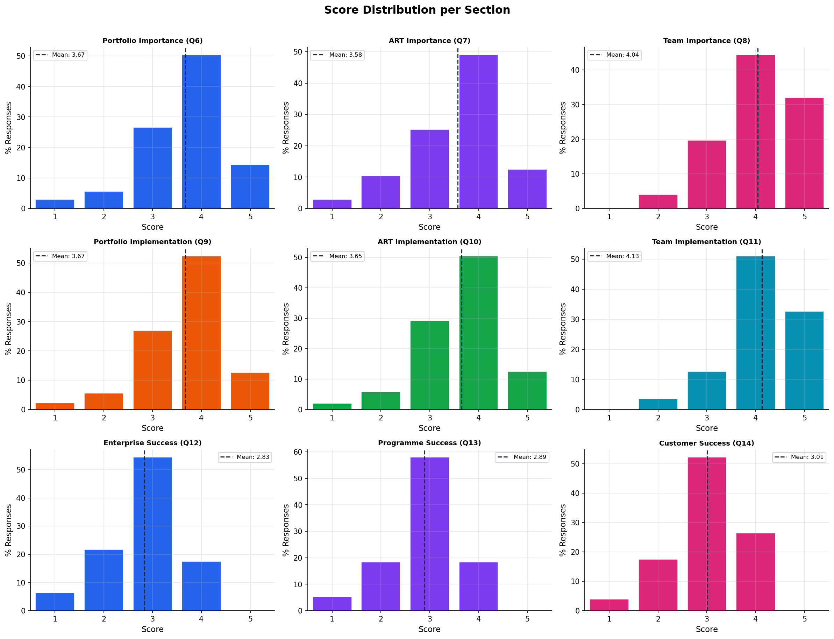
Finding 1 — Team-Level Practices Lead the Way
F1
Sections 8 (importance) & 11 (implementation)
4.13 / 5
Team Implementation
Mean Score (Q11)
4.04 / 5
Team Importance
Mean Score (Q8)
+0.09
Implementation Exceeds
Importance by
Deliver, Build, Test, Define & Deploy are the 5 highest-rated items in the entire survey — all team-level capabilities.

Slide 6
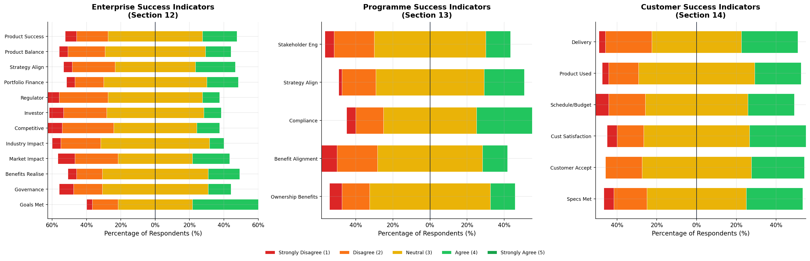
Finding 2 — Success Outcomes Rated Below Neutral
F2
Sections 12 (Enterprise), 13 (Programme) & 14 (Customer)
2.83 / 5
Enterprise Success
Mean (Q12)
2.89 / 5
Programme Success
Mean (Q13)
3.01 / 5
Customer Success
Mean (Q14)
Lowest-rated items: Competitive impact (2.67), Investor impact (2.68), Regulator impact (2.68) — all external-facing success measures.

Slide 7
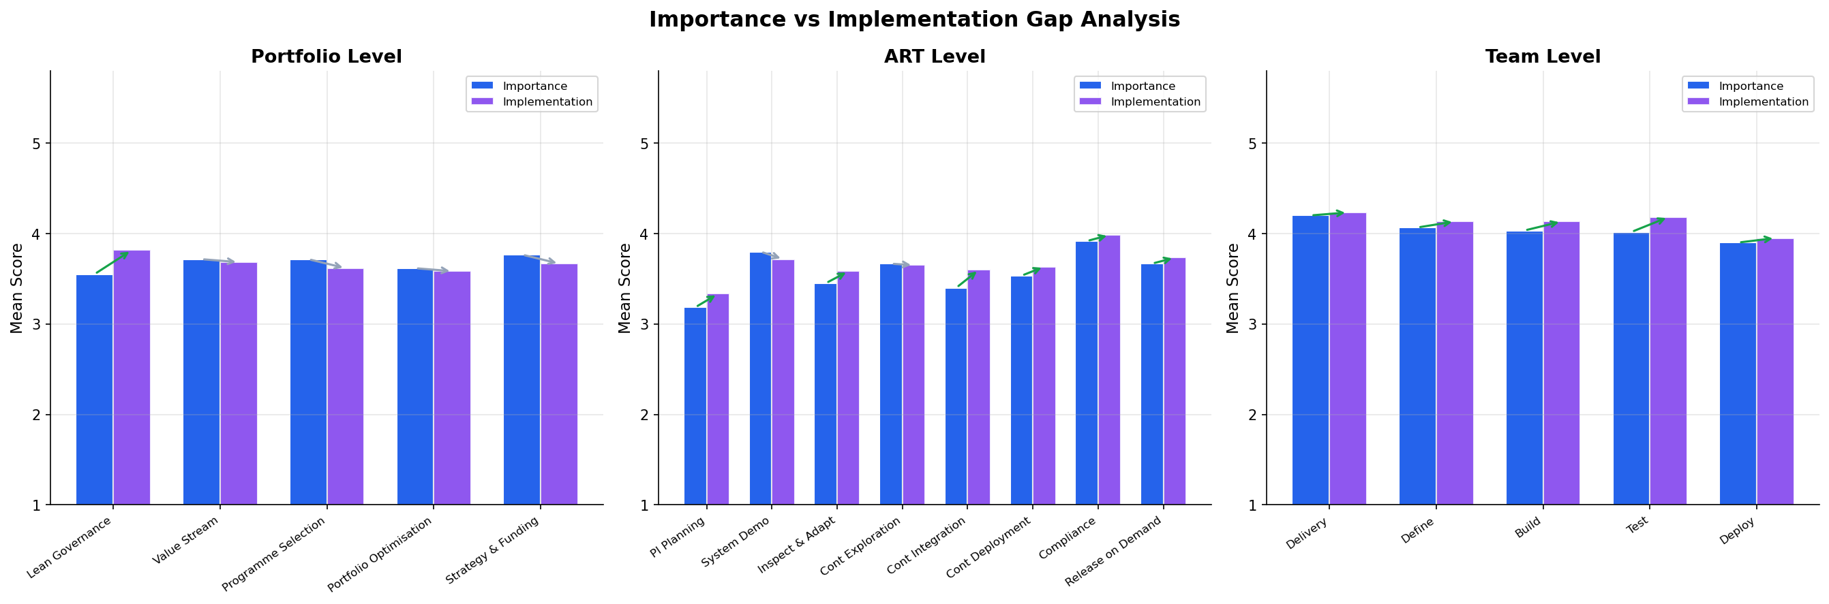
Finding 3 — Importance vs Implementation Gaps Are Small
F3
Comparing what respondents say should happen vs what is happening
< 0.1
Average gap between
importance & implementation
0
Items flagged with a
high gap (> 0.5 threshold)
Interpretation: The issue is NOT that teams are ignoring known practices — they are implementing them. The gap is between doing the work and achieving meaningful outcomes.

Slide 8
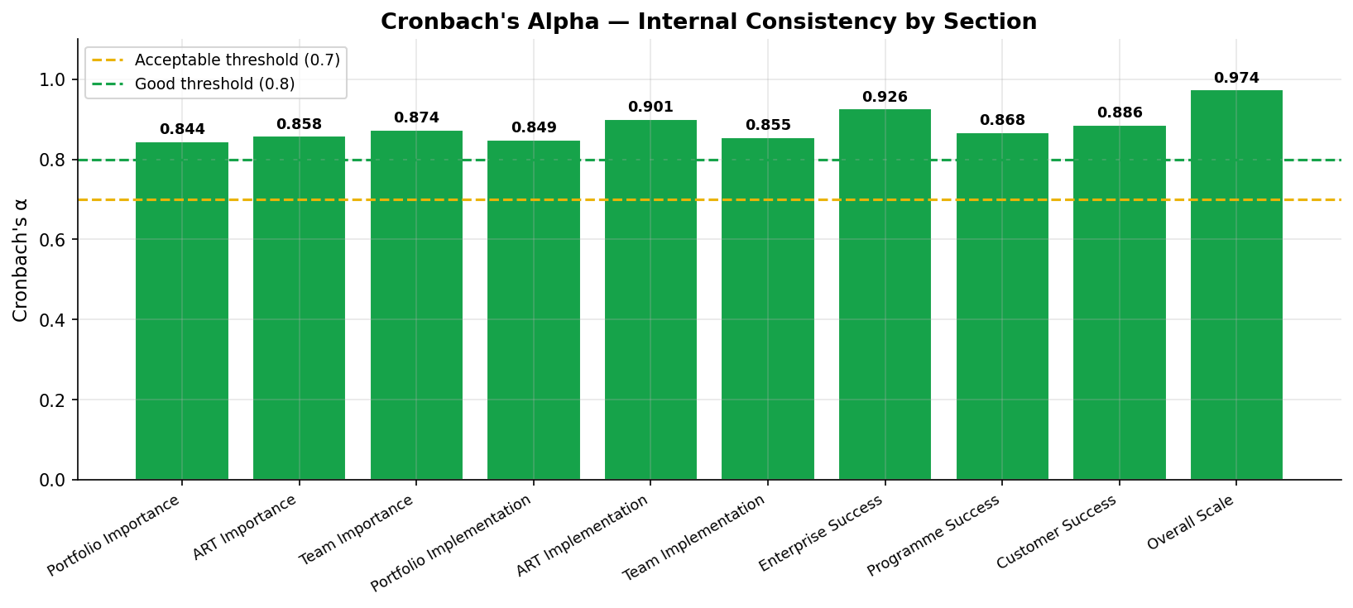
Finding 4 — Survey Instrument Is Highly Reliable
F4
Cronbach's Alpha internal consistency test for all sections
What is Cronbach's Alpha?
Measures whether questions in the same section genuinely measure the same thing.
α ≥ 0.9 = Excellent
α ≥ 0.8 = Good
α ≥ 0.7 = Acceptable
α < 0.7 = Questionable
Overall Scale: α = 0.974 — Excellent
Every section scored "Good" or above.
The survey is a validated, reliable research instrument — results can be reported with confidence in an academic context.

Slide 9
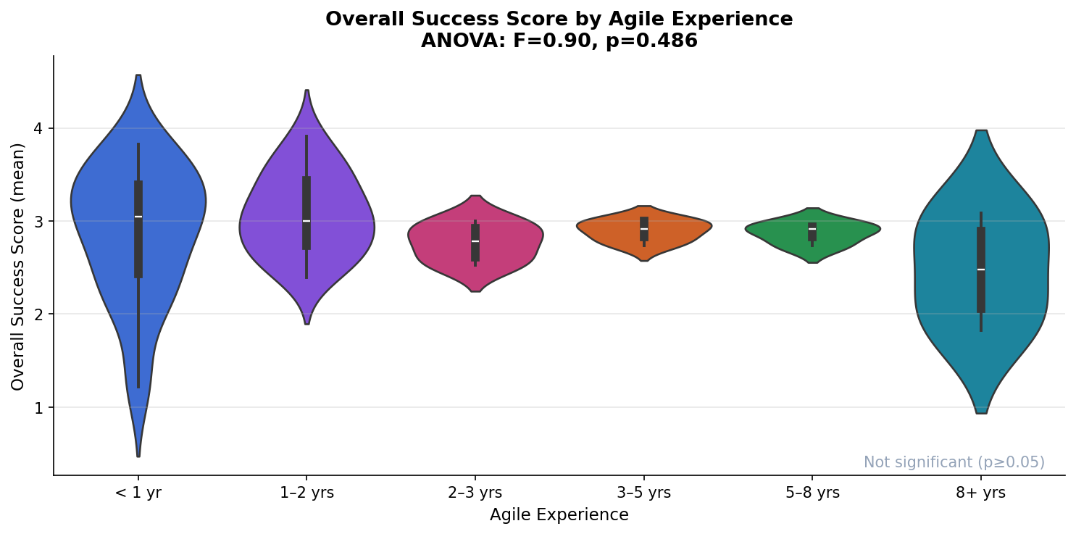
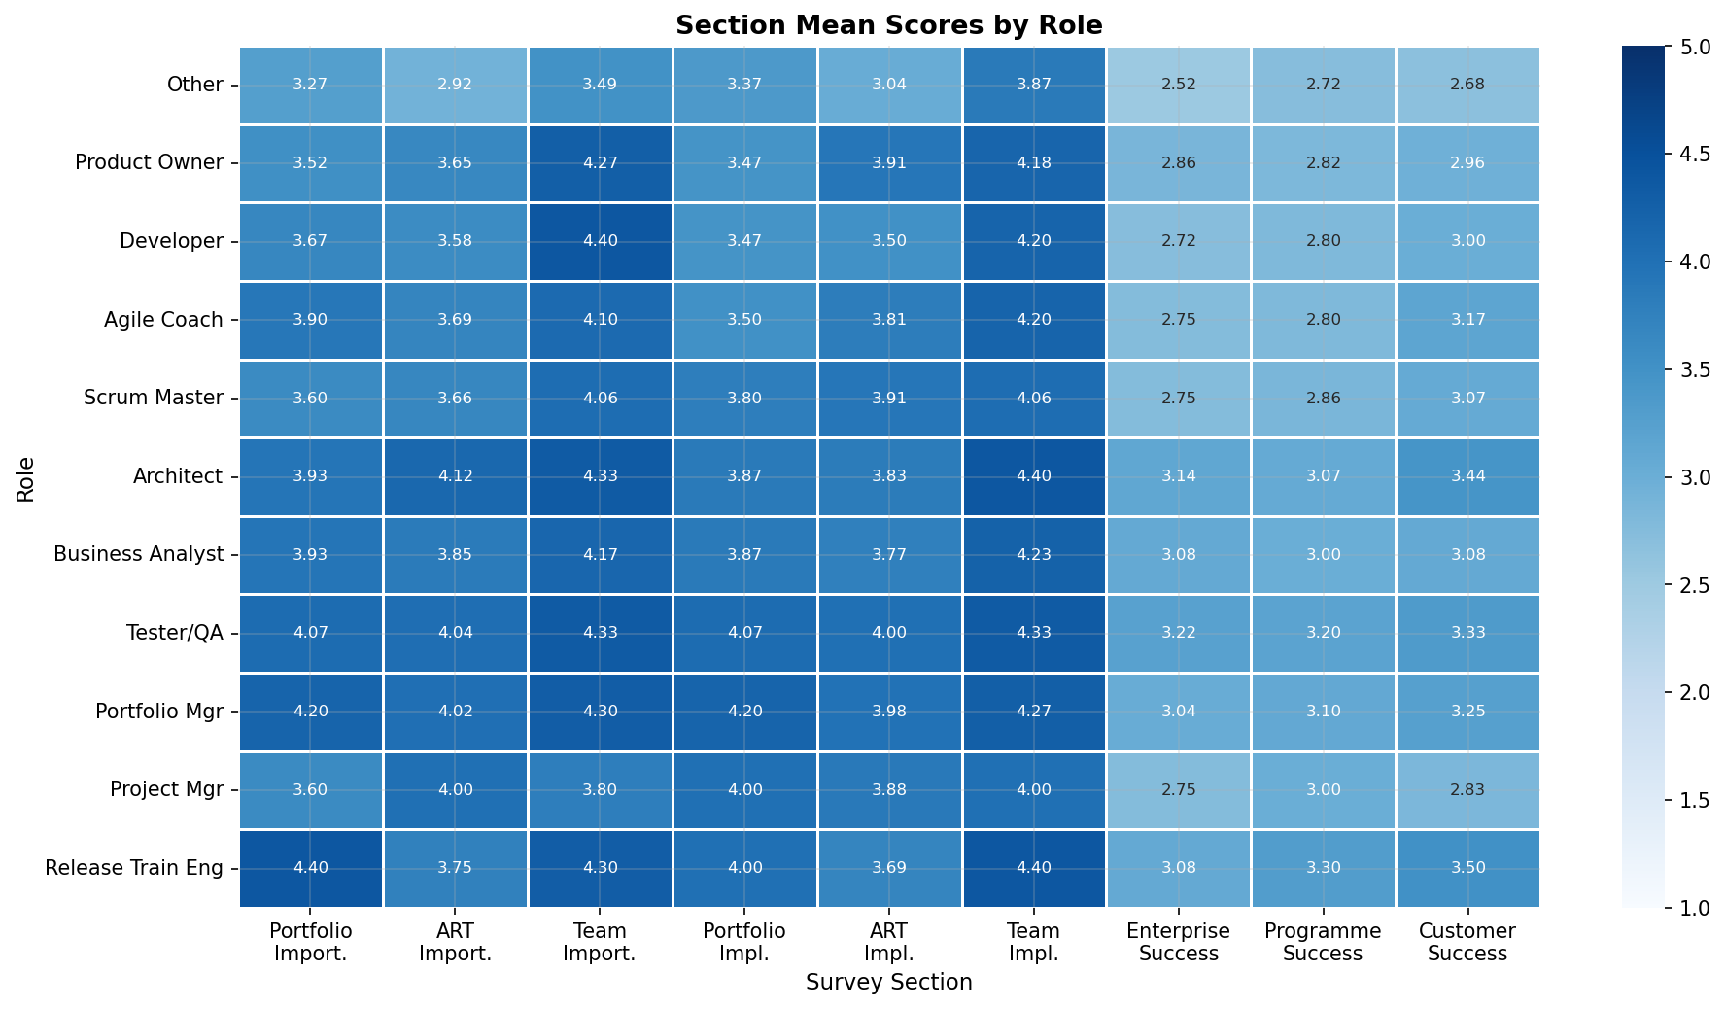
Finding 5 — Experience & Role Shape Perceptions
F5
Subgroup analysis: scores by Agile experience level and job role
By Agile Experience
By Role
ANOVA result: The effect of experience level on success scores was not statistically significant (p ≥ 0.05). All experience groups rate success outcomes similarly — suggesting this is a systemic issue, not a knowledge gap.
Role insight: Most respondents were early-career practitioners (<1 yr experience) and classified as "Other" role. This sampling bias may explain why success indicators score low — newer practitioners may not have seen mature Scaled Agile outcomes yet.

Slide 10
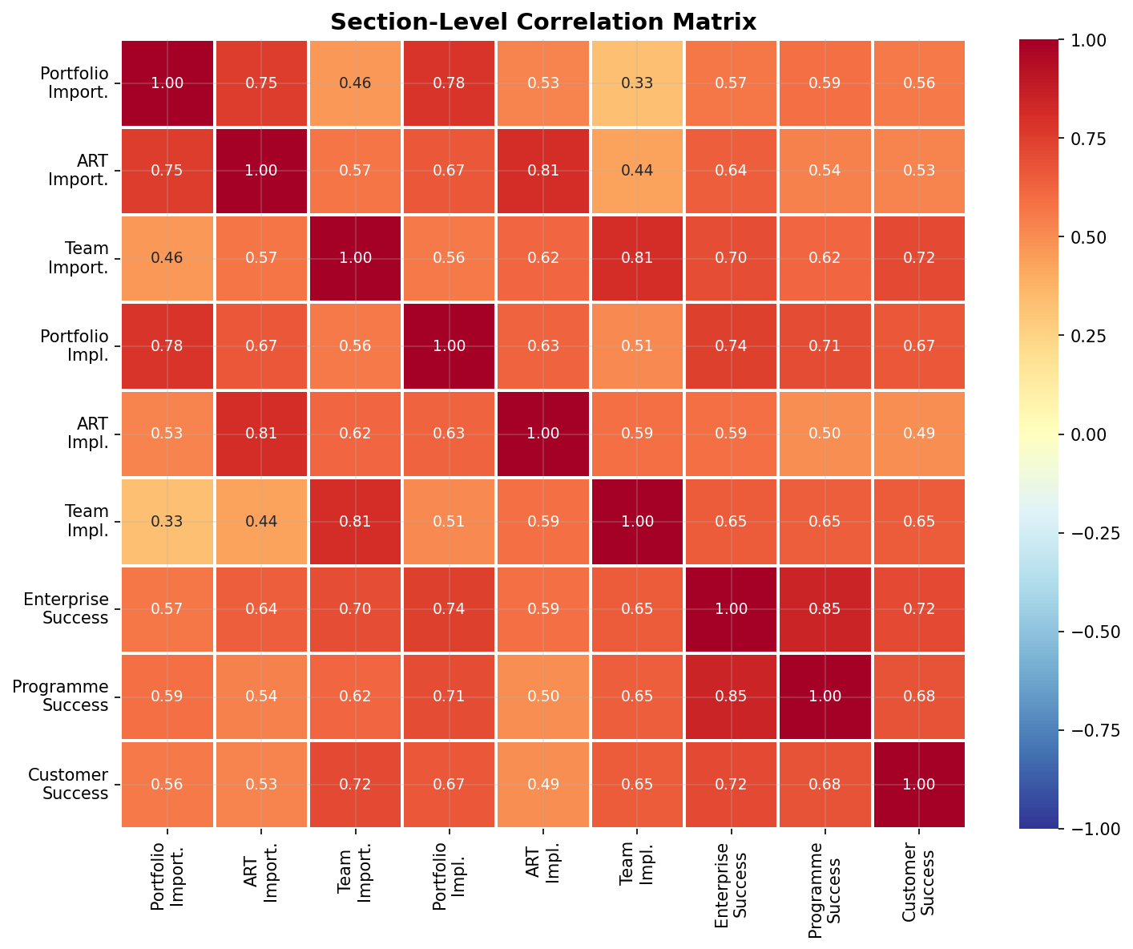
Correlation Insights
How strongly are the different survey sections related to each other?
Portfolio & ART importance scores are strongly correlated (r ≈ 0.7+) — people who value one tend to value the other.
Implementation scores (Q9/Q10/Q11) are tightly correlated with each other — organisations tend to be consistently good or consistently poor at all levels.
Enterprise & Programme success (Q12/Q13) correlate strongly with each other, as expected — they measure related outcomes.
Customer success (Q14) correlates moderately with Enterprise success — external outcomes are linked but not identical to internal metrics.
Weakest link: Importance scores (Q6–Q8) have low correlation with success outcome scores (Q12–Q14) — valuing practices does not automatically lead to better outcomes.

Slide 11
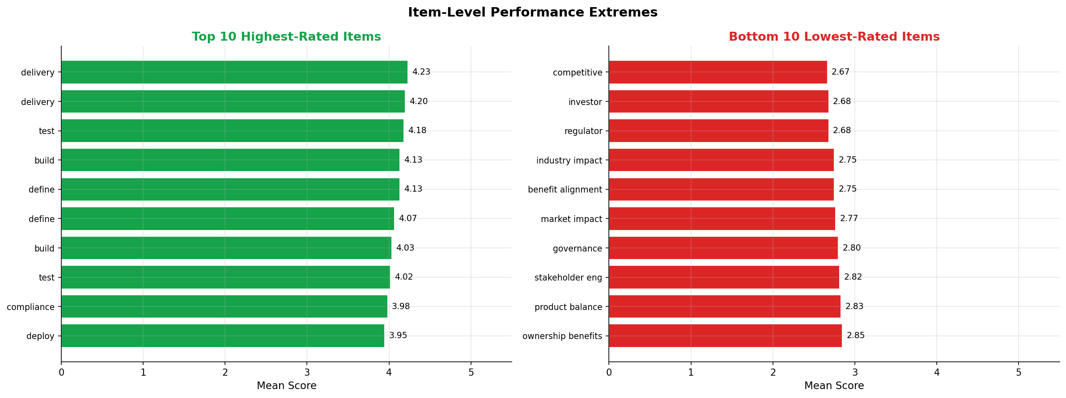
Highest & Lowest Rated Items
Individual question means — what respondents value most and least
Top items are all team-level execution capabilities — Delivery, Test, Build, Define, Deploy. These should be core framework pillars.
Bottom items are external success metrics — competitive, investor, regulator & industry impact. These need targeted intervention.

Slide 12
Conclusions & Recommendations
F1
Team execution is the foundation
Place Build, Test, Define, Deploy, and Deliver at the core of the conceptual framework — these are what practitioners value most and do best.
F2
Success outcomes need a bridge
Doing the practices is not enough. The framework must explain HOW team-level execution connects to enterprise/customer outcomes.
F3
Alignment exists — close the loop
Low importance–implementation gaps show organisations are walking the talk. Focus research on outcome measurement, not practice adoption.
F4
Findings are statistically sound
All Cronbach's α values exceed 0.84. The data is reliable enough to support regression analysis or structural equation modelling.
F5
Validate with experienced sample
Most respondents are early-career. A follow-up study targeting 3+ year practitioners may reveal higher success scores and stronger correlations.

